Slide 1

Integrated Circuit 555
Team Amplifiers
Presented by:
Ashish Shelake,
Siddhi Bhosale,
Vedant Bhoir
Vijay Balsubramaniam
Vishwanath Shikhare
{Class XII-B Sci}

Slide 2

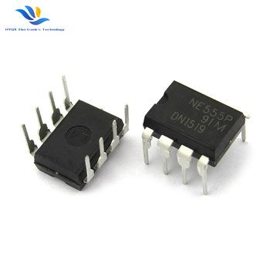
Overview:
Block Diagram of IC 555
IC 555 as Monostable Multivibrator
IC 555 as Bistable Multivibrator
IC 555 as Astable Multivibrator
IC 555 as Frequency Shift Keyer

Slide 3
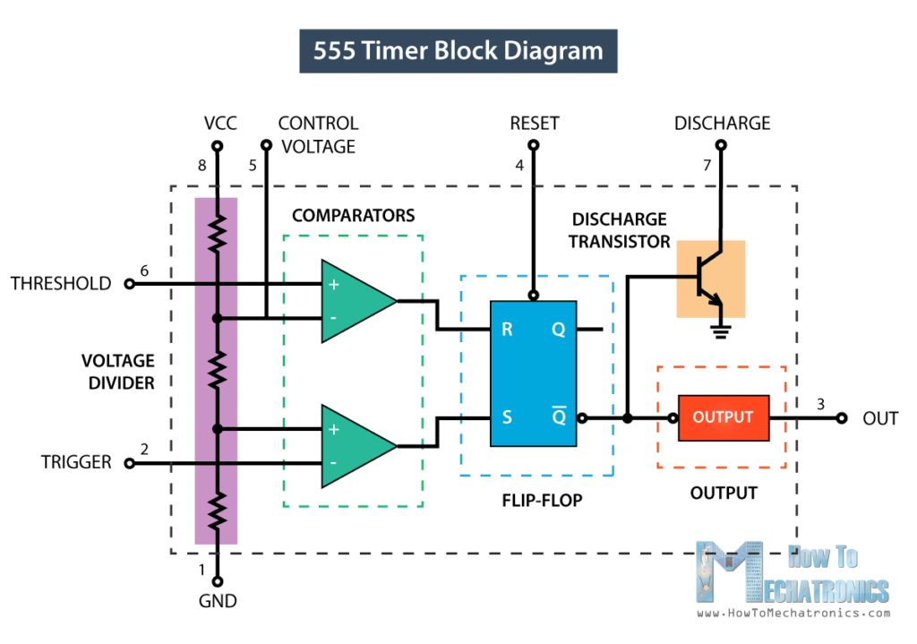
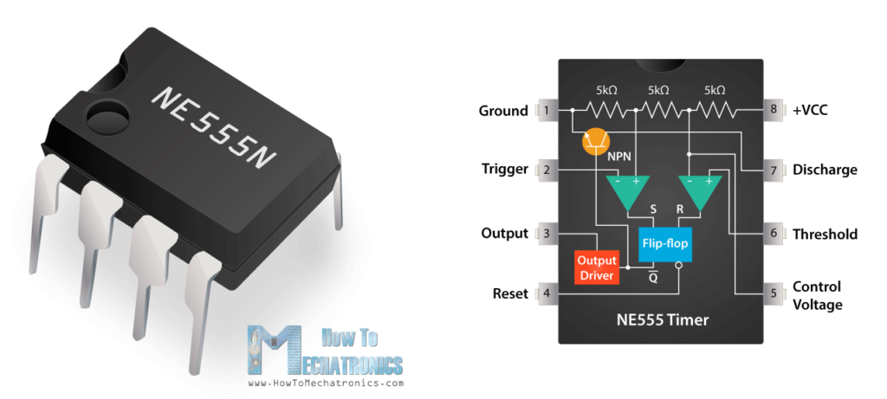
3

Slide 4
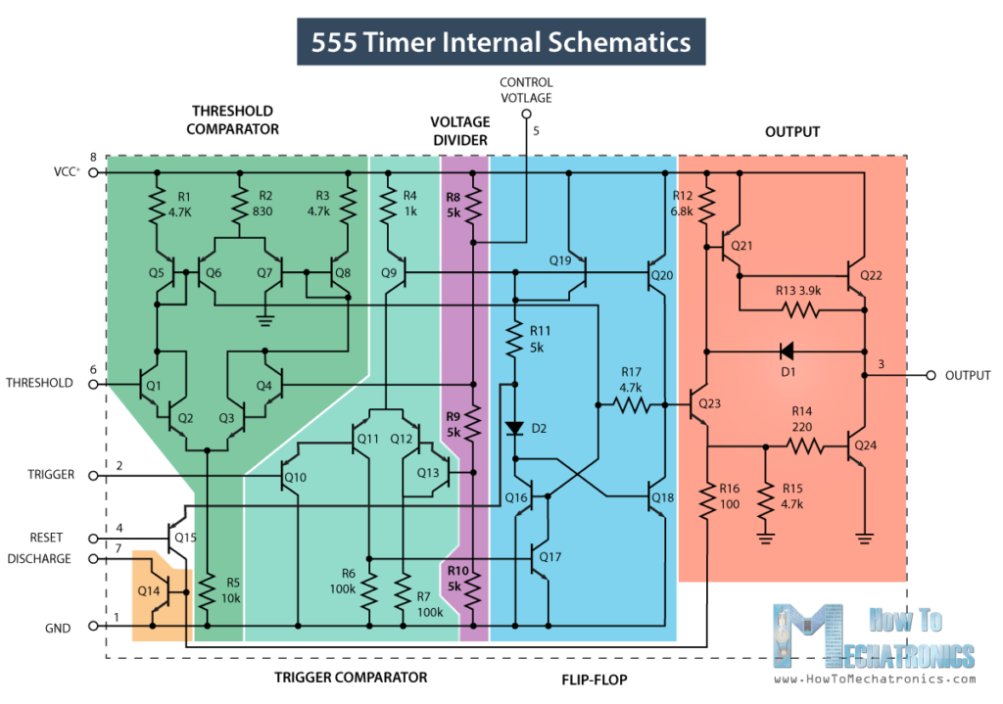
IC 555 is Used In:
Controlling the speed of Wipers
Automatic Time-based Circuits
LED Flasher Circuits
Clap Switch Circuits
Frequency Shift Keying
Low Power Ultrasonic Wave Generators
4

Slide 5
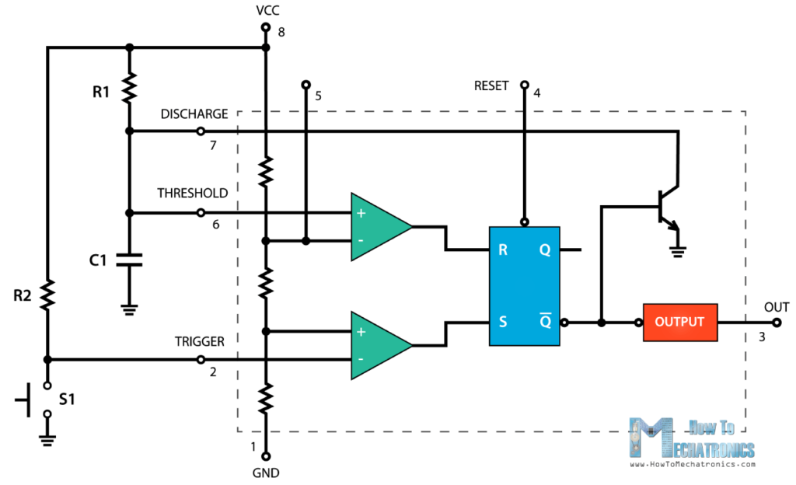
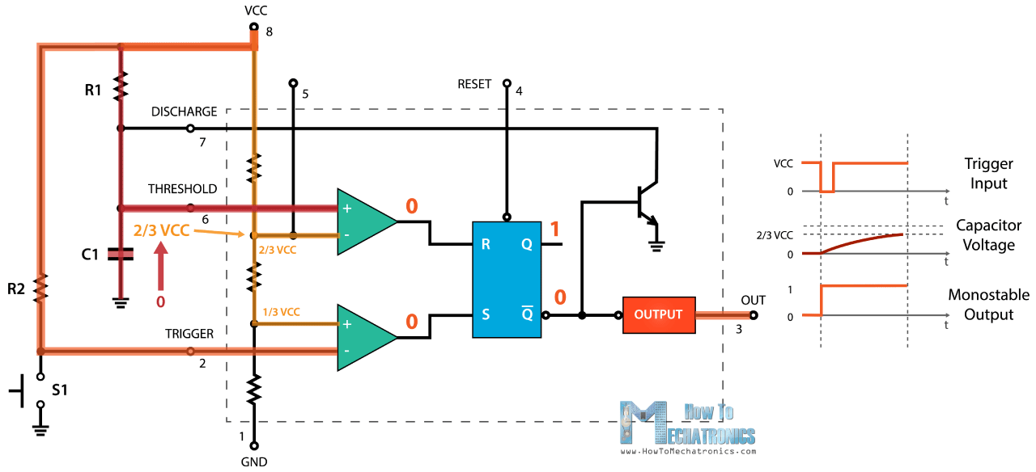
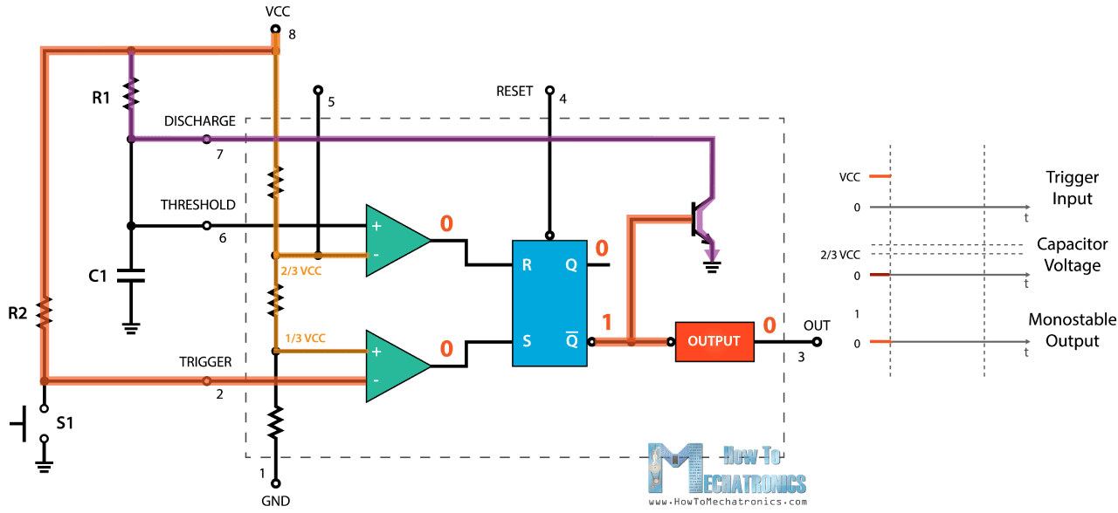
IC 555 Timer as Monostable Multivibrator

Slide 6
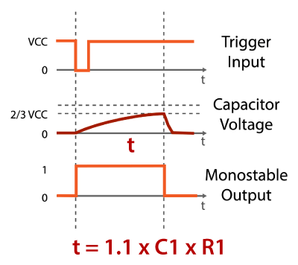
Characteristics of Monostable Multivibrator
Only the Trigger input is under manual operation, the timer function is automatic
The time period of output can be controlled by replacing R₁ with a Potentiometer
Mathematical Calculation of Time of Output (T_{monostable}) is possible using the formula given alongside.
Only one switch is used

Slide 7
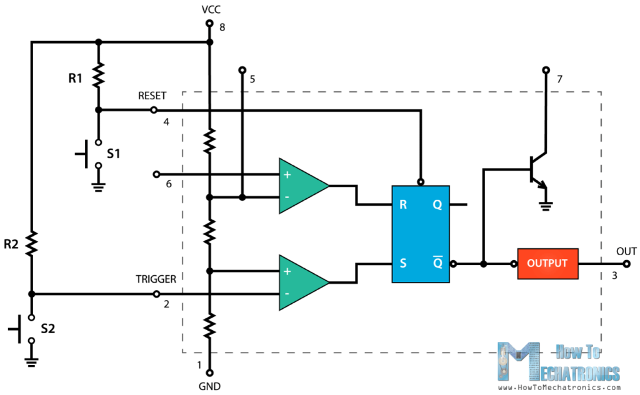
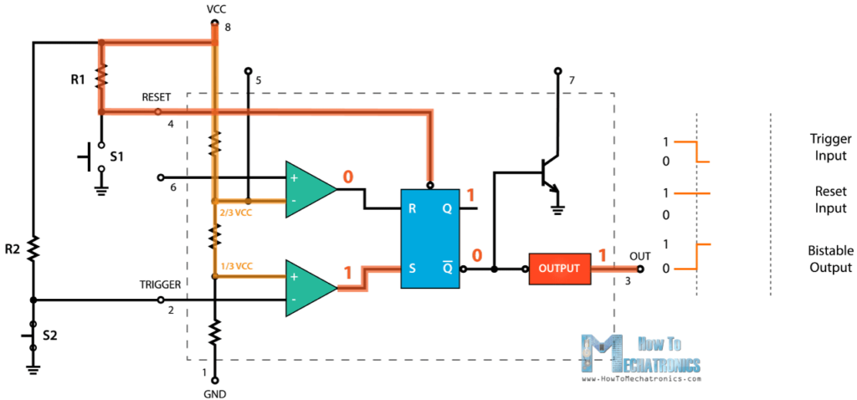
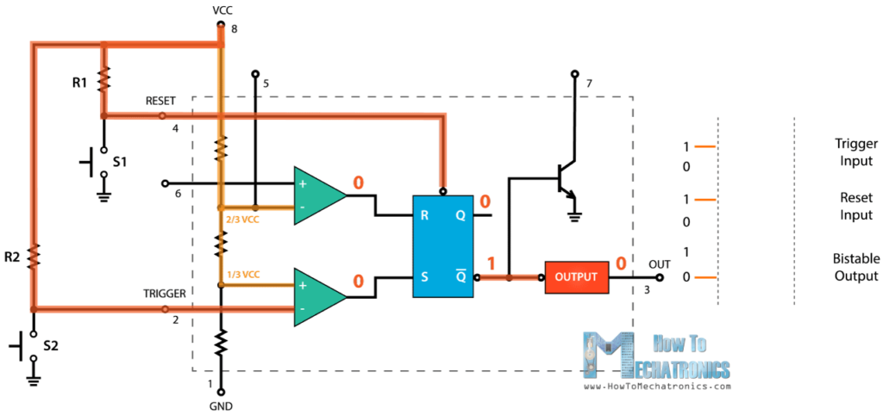
IC 555 Timer as Bistable Multivibrator

Slide 8
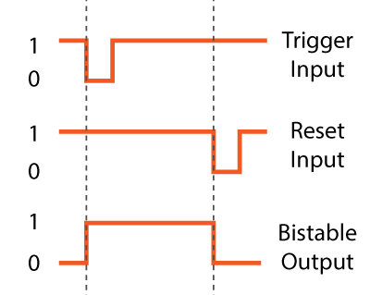
Characteristics of Bistable Multivibrator
The Timer operation as well as the Trigger input are manually operated
The Memory of the RS Flip Flop keeps the output driver functioning until the reset input is driven low
Two switches are used

Slide 9
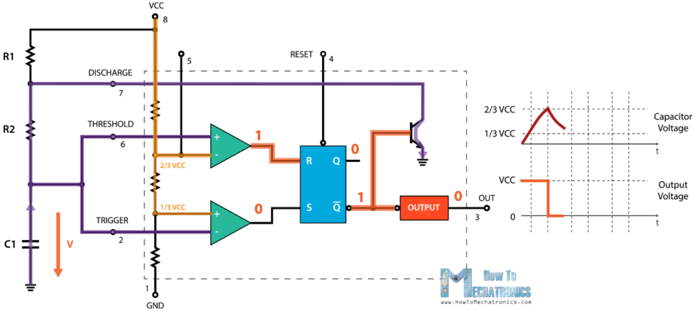
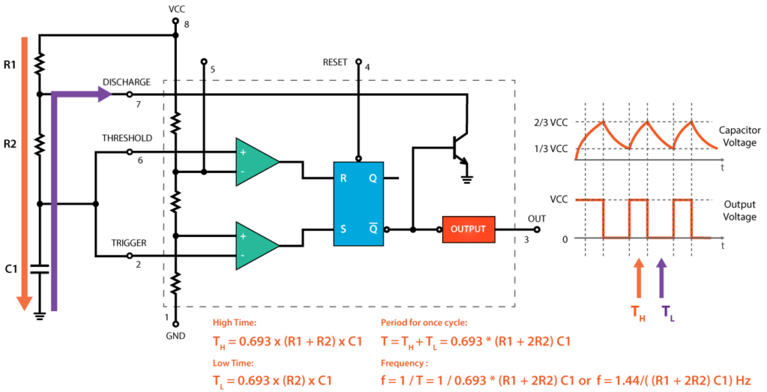
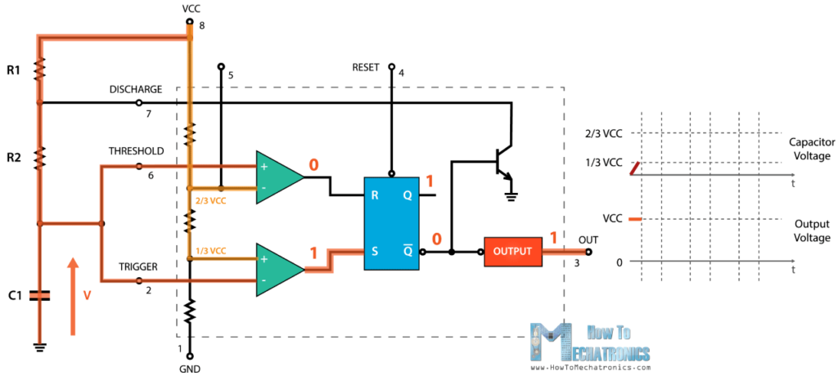
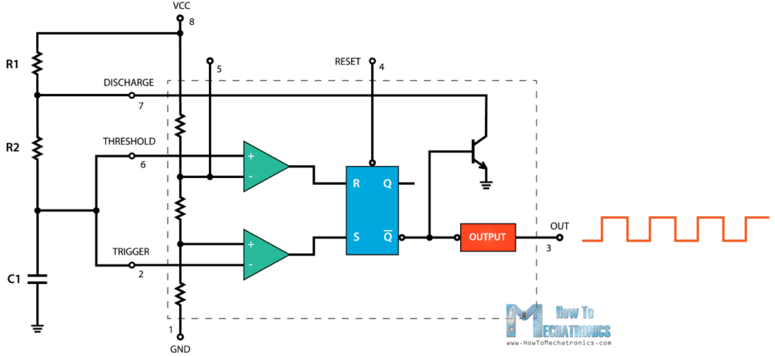
IC 555 Timer as Astable Multivibrator

Slide 10
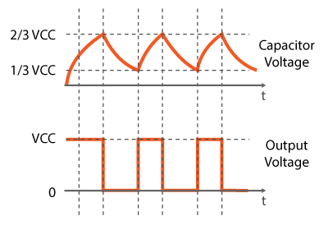

Characteristics of Astable Multivibrator
The Timer Operation and the Trigger Input both are automatic
The time for which output is high as well as that for when it is low cane be calculated mathematically
The time period can be externally changed by using Potentiometers instead of R₁ and R₂

Slide 11
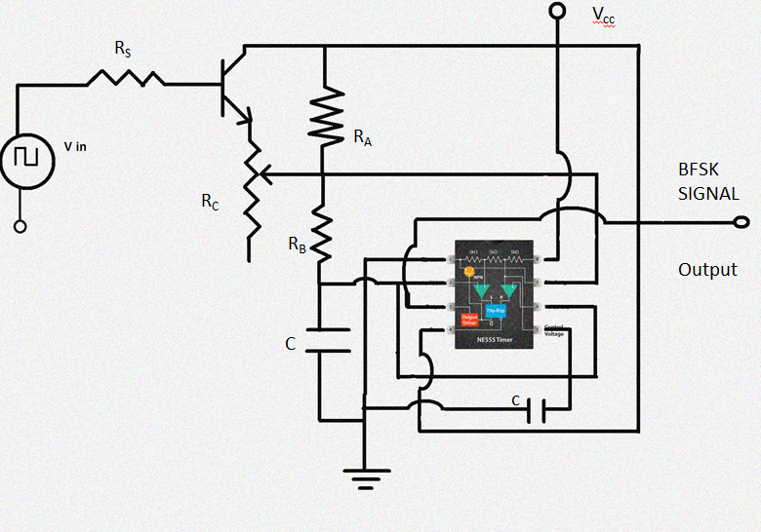
IC 555 Timer as Frequency Shift Key

Slide 12
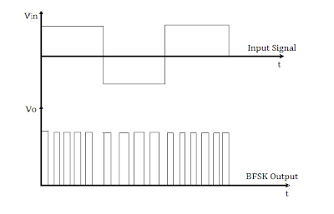
IC 555 Timer in Frequency Modulation Circuits
The frequency of operation is given by the expression
F_{o} = 1.45/(R_{a}+2R_{b})
The potentiometer Ra is used to fine tune the frequency.
When the input is at logic 1, frequency of operation is given by the expression
F_{o} = 1.45/(R_{a}//R_{s} + 2R_{b})

Slide 13
THANK YOU!

